Slide 1
Data exploratıon report
GROUP ESPOR

Slide 2
The Source of Data
We took our data from Kaggle. By using the StandardScaler library, data has been normalized by using mean and standard deviation of new position of the machine
https://www.kaggle.com/inIT-OWL/vega-shrinkwrapper-runtofailure-data
We used Self Organizing Maps to analyze the data
https://www.sciencedirect.com/science/article/pii/S221282711830307X

Slide 3
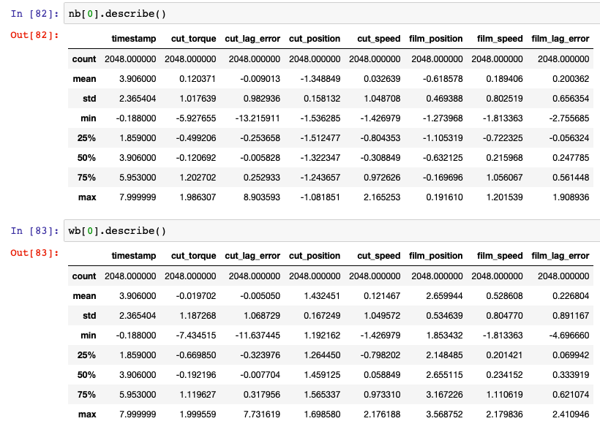
Feature List
Seven components were used to analyze the performance of machines;
Cut_torque
Cut_lag_error
Cut_position
Cut_speed
Film_position
Film_speed
Film_lag_error
By using the StandardScaler library, data has been normalized by using mean and standard deviation of the normal position of the machine.

Slide 4
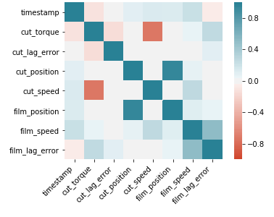
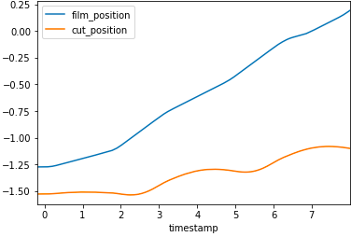
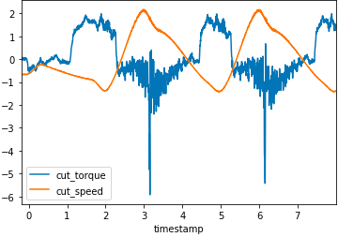
Statistical Exploration
Correlation between variables was analyzed
high negative correlation between cut_torque and cut_speed
high positive correlation between cut_position and film_position

Slide 5
ML Methods
In this study, we have implemented two different methods of Machine Learning.
Unsupervised Artificial Neural Network
Clustering
Because of the misfit of Supervised Artificial Neural Network, we implemented Unsupervised one. Our data and modelling is more suitable for Unsupervised one because we tried to find thing we don’t have in variables, data.

Slide 6
Sezgi Altun
Muhammed Ali Metin
Alperen Yıldız
Aşkın Caner Akkuş
Feyzi Can Bağbozan
Barış Koç
THANK YOU

